Slide 1

Detection of Text from Morse Code in Images using CNN
Under Guidance Of Presented By
SK. Johny Basha 19761A0528
Sr. Asst. Prof 19761A0537
20765A0505

Slide 2
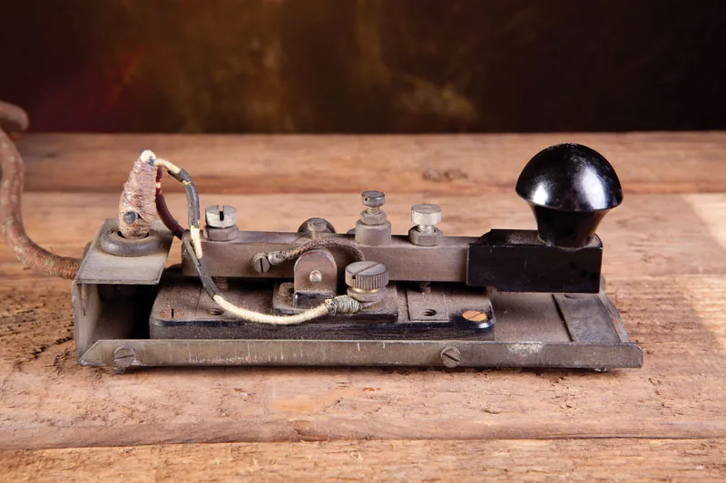
Introduction
Morse Code is a method of telecommunication, used to transmit messages to long distances across telegraph wires via electronic pulses, represented as short pulse(dot) and long pulse(dash).
In the late 1830’s, the way of communication is either face-to-face or via ravens, for the first time in the history of mankind a group of scientists created a telecommunication device called telegraph, which is used to transmit the electric pulses to the other device.

Slide 3
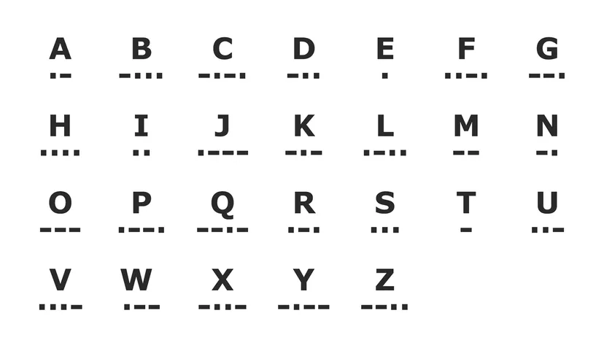
Morse Code
Hence, Samuel F.B. Morse invented a communication language which can be used with electronic pulse signals for the communication.
Here, One short electronic pulse and one long electronic pulse can be represented as A and one long pulse, three short pulses can be represented as B. In this way they have successfully invented a communication language which can be associated with electronic pulses to transmit the messages to destinations.

Slide 4
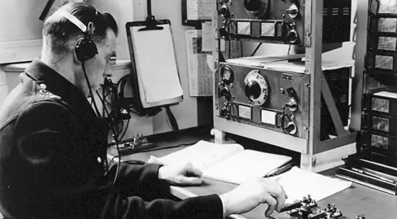
Usage
Morse code was used to communicate with the people who are in longer distances. Especially it was used in World War 2, Korean and Vietnam wars. It was used heavily by the shipping industry and for the safety of the seas until the early 1990’s.
Even now a days, Morse code is widely used in Aviation and Aeronautical fields, even the US Navy and Coast Guard still use signal lamps to communicate via Morse Code

Slide 5
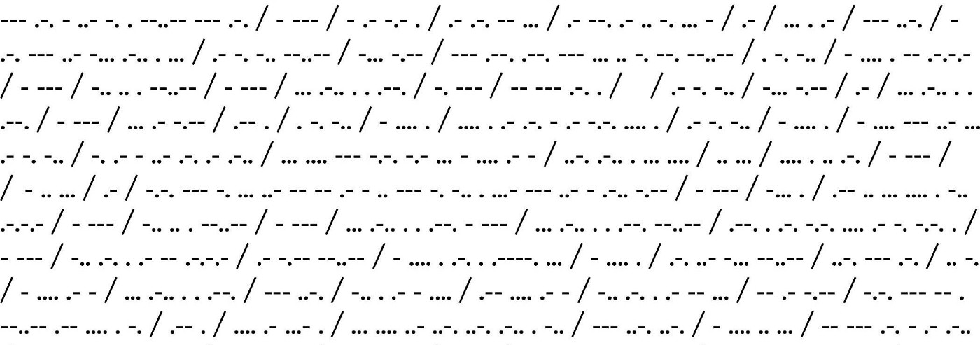
Project Overview
Detection of text from images of morse code is a complex process and there is no active research in this area. As these are images, different people can have different styles of writing.
Even though we have these problems, we intend to built a machine learning model which will extract the morse code present in the input image and convert that morse code to the English language with the help of convolutional neural networks with as accuracy of 90%.

Slide 6
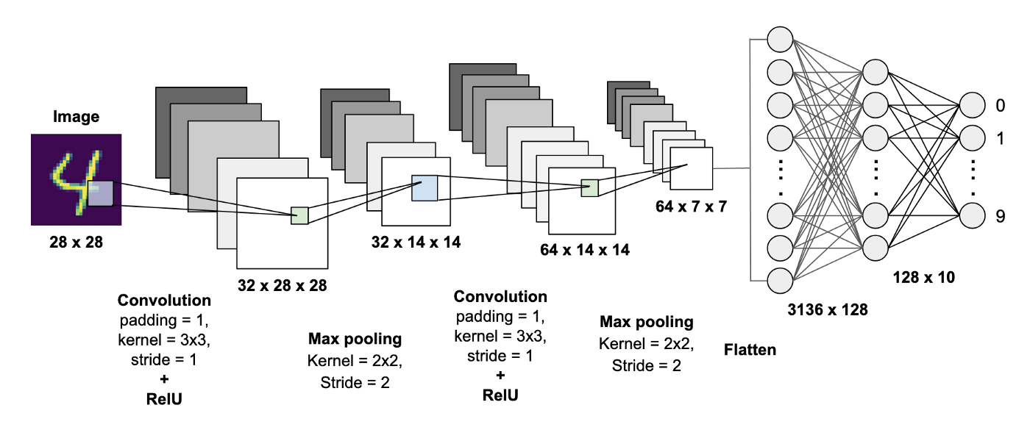
CNN – Convolutional Neural Networks
CNN’s are mainly used for image recognition, object classification and pattern recognition. In the CNN, the feature extraction process will takes place, where the important part of the image will be taken into consideration.
In CNN, there are three layer i.e : a convolutional layer, pooling layer and a fully connected layer. The Convolutional layers will find the patterns present in the image.In Pooling layer, the important features will be extracted.Fully connected layer is where the image classification takes place.

Slide 7

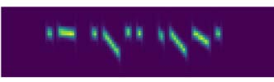
Motivation
Base Paper : https://ieeexplore.ieee.org/document/9051374
In this paper, the deep learning method is introduced to construct a neural network model as the Morse decoding system, which is a novel approach in the relevant field.
Here, the time frequency signals i.e : audio signals are taken as input to the model, CNN’s are used to extract the important features from the input, BLSTM network used to label feature frames from CNN. Then the RNN’s are used for the sequential based character recognition.

Slide 8
Objectives
We are building a dataset, which consists of 100 images of each character present in morse code, as there are 36 characters we intend to create a dataset consisting of 3,600 images.
Performing data segmentation on the input images
Predicting the segmented images individually
Combining the outputs for the final result i.e : English text

Slide 9
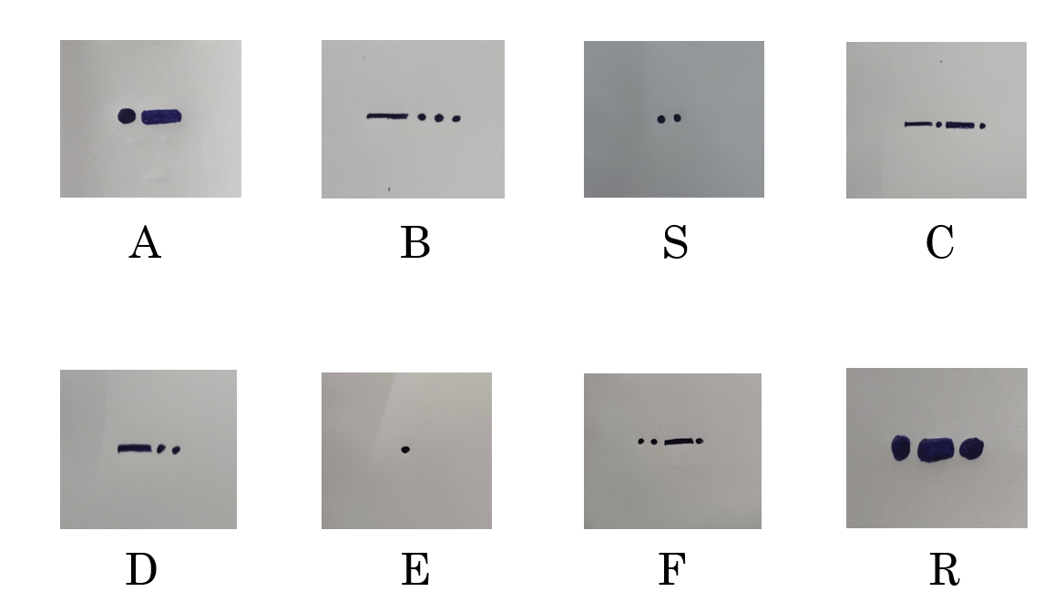
DATASET CREATION

Slide 10
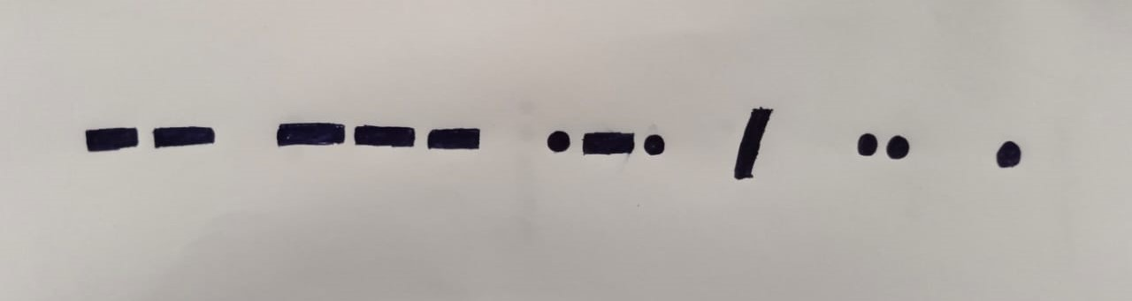
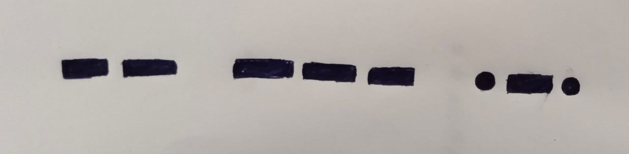
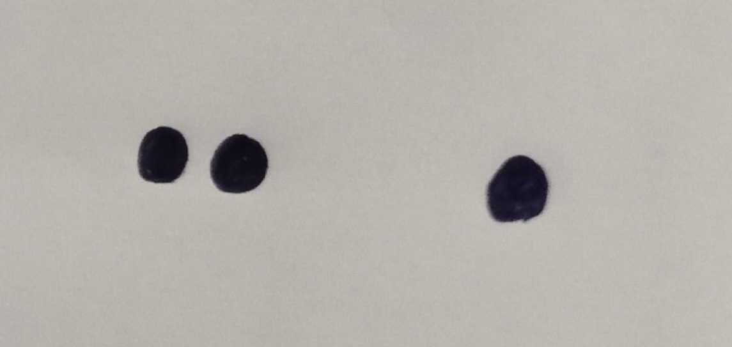
DATA SEGMENTATION
BEFORE WORD SEGMENTATION
WORD - 1
WORD - 2

Slide 11
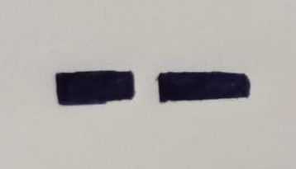
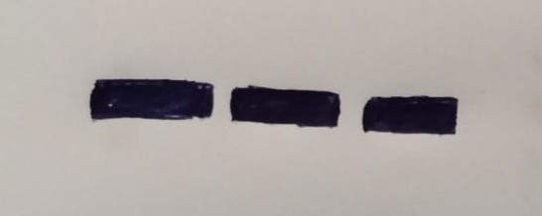
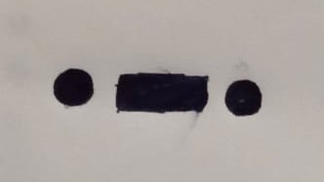
CHARACTER SEGMENTATION
BEFORE CHARACTER SEGMENTATION
CHARACTER - 1
CHARACTER - 2
CHARACTER - 3

Slide 12
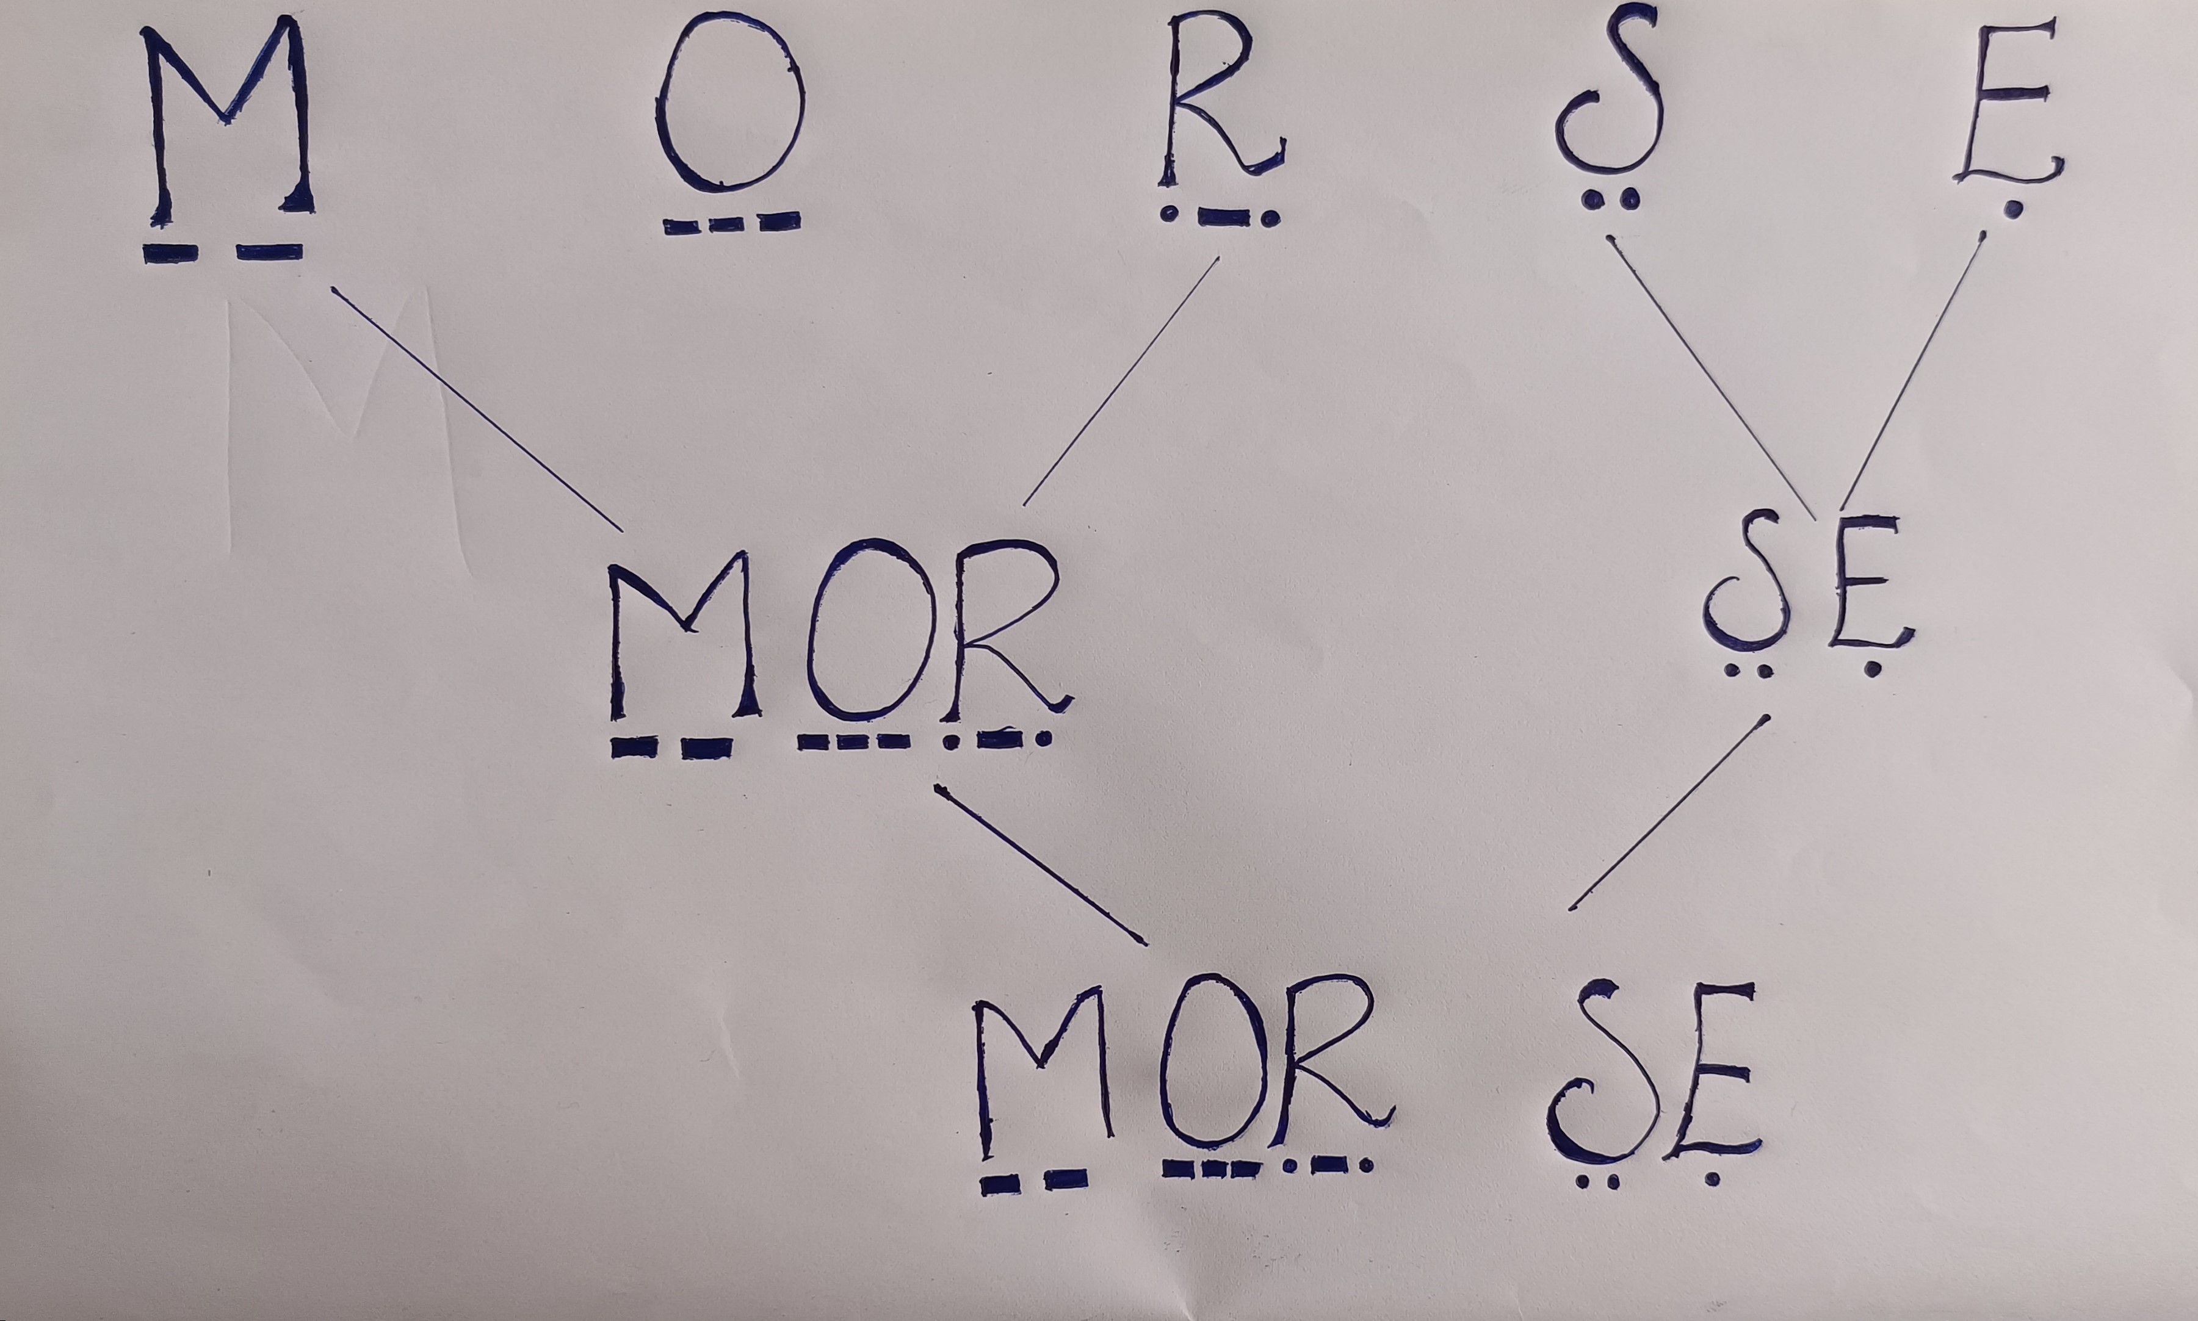
COMBINING THE SEGMENTS

Slide 13
Literature Survey
Research on Automatic Decoding of Morse Code Based on Deep Learning
Advantages : The model will detect the morse code present in the audio and then convert it into English text with 90% accuracy
Limitations : We can only give frequency signals(audio) as input and moreover many times the high pitch signals cannot be predicted effectively.
Morse Code Datasets for Machine Learning
Advantages : We can create the datasets for the morse code symbols effectively, so that any machine learning algorithms can be applied to get the predictions of the morse code images.
Limitations : In every image the space between the long pulse and short pulse must be same, if it differs then the whole model will be effected.

Slide 14
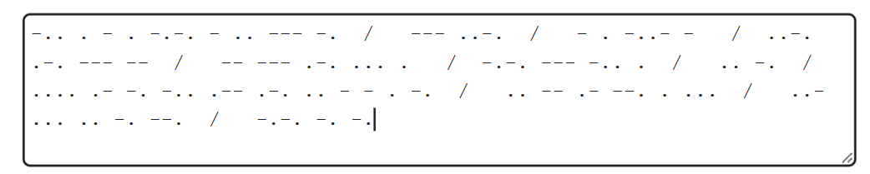
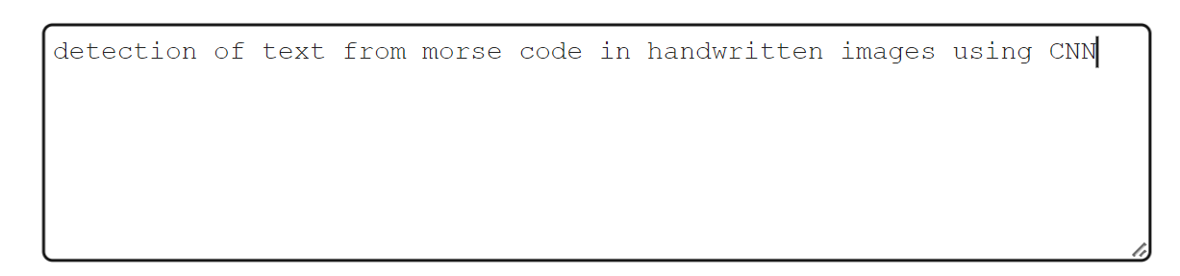
Conclusion
We will built a machine learning model, which take morse code images as input, detect the morse code and then convert it into English text with an accuracy of 90%.
INPUT EXPECTED OUTPUT

Slide 15
THANK YOU

